Slide 1
Controlling access to class members - Encapsulation

Slide 2
Terminology
Access Modifier
determines access rights for the class and its members
defines where the class and its members can be used

Slide 3
Why use these
It is important in many applications to hide data from the programmer
E.g., a password program must be able to read in a password and compare it to the current one or allow it to be changed
But the password should never be accessed directly!
public class Password {
public String my_password;
:
}
Password ProtectMe;
:
ProtectMe.my_password = “backdoor”; // this is bad

Slide 4
Access Modifiers
Member modifiers change the way class members can be used
Access modifiers describe how a member can be accessed
Modifier | Description
(no modifier) | member is accessible within its package only
public | member is accessible from any class of any package
Protected | member is accessible in its class package and by its subclasses
Private | member is accessible only from its class

Slide 5
public vs. private
Classes are usually declared to be public
Instance variables are usually declared to be private
Methods that will be called by the client of the class are usually declared to be public
Methods that will be called only by other methods of the class are usually declared to be private

Slide 6
Public etc
public means that any class can access the data/methods
private means that only the class can access the data/methods
protected means that only the class and its subclasses can access the data/methods

Slide 7
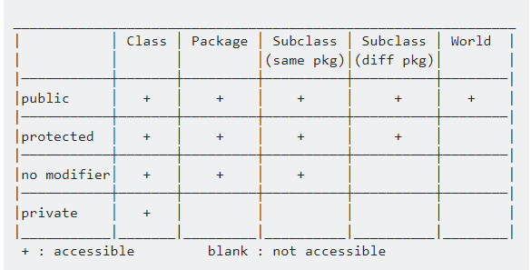

Slide 8
Information Hiding
To drive a car, do you need to know how the engine works? Why?
println method
need to know what the method does
but not how println does it
Provide a more abstract view and hide the details

Slide 9
Defining Encapsulation
Encapsulation is the process of hiding an object’s implementation from another object, while presenting only the interfaces that should be visible.
Encapsulation is the technique for packaging the information in such a way as to hide what should be hidden, and make visible what is intended to be visible.
Notes:
Notes:
Encapsulation is the process of hiding details of an object or function. Implementation hiding is a powerful programming technique because it reduces complexity.
Encapsulation means to design, produce, and describe software so that it can be easily used without knowing the details of how it works.

Slide 10
Principles of Encapsulation
“Don’t ask how I do it, but this is what I can do”
- The encapsulated object
“I don’t care how, just do your job, and I’ll do mine”
- One encapsulated object to another
Notes:
Faculty Notes
Encapsulation means to design, produce, and describe software so that it can be easily used without knowing the details of how it works.
Programmers should only concern themselves with learning how to use an object, not how it works.

Slide 11
Encapsulating a Class
Members of a class must always be declared with the minimum level of visibility.
Provide setters and getters (also known as accessors/mutators) to allow controlled access to private data.
Provide other public methods (known as interfaces ) that other objects must adhere to in order to interact with the object.
Notes:
Faculty Notes

Slide 12
Accessors and Mutators
Accessor methods—public methods that allow attributes (instance variables) to be read
Get methods are also commonly called accessor methods or query methods.
Check to make sure that changes are appropriate.
Much better than making instance variables public
Mutator methods—public methods that allow attributes (instance variables) to be modified
Set methods are also commonly called mutator methods, because they typically change an object’s state—i.e., modify the values of instance variables.
private attributes (instance variables) with public accessor and mutator methods.

Slide 13
Setters and Getters
Setters and Getters allow controlled access to class data
Setters are methods that (only) alter the state of an object
Use setters to validate data before changing the object state
Getters are methods that (only) return information about the state of an object
Use getters to format data before returning the object’s state
Notes:
Talking Points:
The purpose and focus of this slide is to show the use of setters and getters as part of protecting data in encapsulation.
Setters and getters should be named by:
Capitalizing the first letter of the variable (first becomes First), and
Prefixing the name with get or set (setFirst)
For boolean variables, you can replace get with is (for example, isRunning)
This is more than just a convention—if and when you start using JavaBeans, it becomes a requirement

Slide 14
Encapsulation ensures that structural changes remain local
Changes in the code create software maintenance problems
Usually, the structure of a class (as defined by its fields) changes more often than the class’s constructors and methods
Encapsulation ensures that when fields change, no changes are needed in other classes (a principle known as “locality”)

Slide 15
END

